Slide 1
jQuery Begins
Lesson 5.1

Slide 2
Admin Items
jQuery $(Begins)

Slide 3

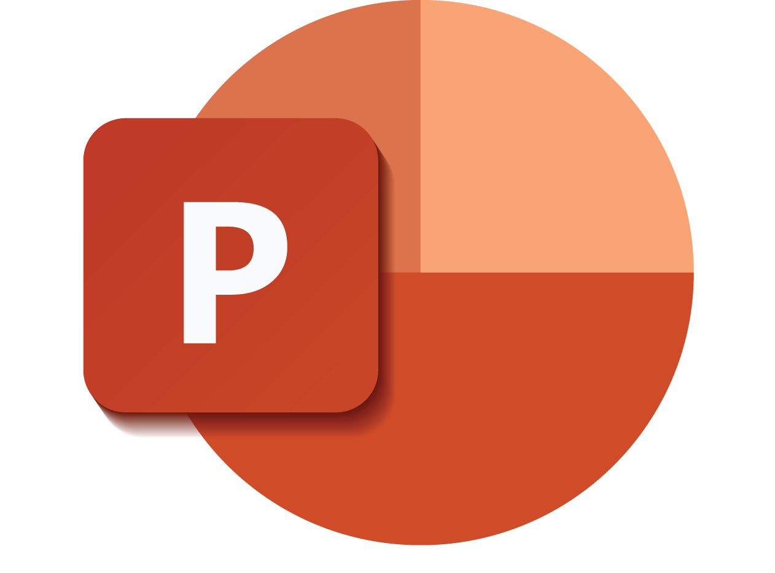
Death by PowerPoint: Not the Way to Learn Coding
jQuery $(Begins)
Notes:
Image from: shutterstock_470084681

Slide 4

True Way to Learn Coding
jQuery $(Begins)
Notes:
Image from: shutterstock_589180820

Slide 5
Be prepared to have classes that are increasingly “just code.”
(You will appreciate it in the long run.)
jQuery $(Begins)

Slide 6
Today’s Class
jQuery $(Begins)

Slide 7


Agenda
In today’s class we’ll be covering:
DOM manipulation using plain JavaScript
DOM manipulation using jQuery
Responding to click events
jQuery $(Begins)

Slide 8
DOM Manipulation
jQuery $(Begins)

Slide 9
Understanding the DOM
Basic Example: todomvc.com
Every HTML page begins as static content.
However, with Javascript/jQuery, we can modify the DOM and change this static content in real time.
This allows us to build dynamic sites.
jQuery $(Begins)
Notes:
* Spend a few moments explaining the concept of DOM manipulation. If you are hazy about the concept of the DOM, you may want to read this article <https://css-tricks.com/dom/>.
* Effectively the DOM is the version of HTML / CSS interpreted by the browser.
* With regards to the slide, we can use JavaScript and jQuery to modify the DOM to dynamically change the HTML that gets displayed.
* Visit the to-do list site on the slide [http://todomvc.com/examples/jquery/#/all
](http://todomvc.com/examples/jquery/#/all) to provide a simple example that the addition of to-dos is effectively adding HTML in real-time.
* You can even go into the Chrome Developer tools to show this more clearly.

Slide 10
01-DOM-Manipulation
jQuery $(Begins)

Slide 11
Activity: Generating HTML with Plain JavaScript
02-JSDrinkList
jQuery $(Begins)
Notes:
15 minutes

Slide 12
Intro to jQuery
jQuery $(Begins)

Slide 13

Intro to jQuery
jquery.com
jQuery is a cross-platform JavaScript library designed to simplify client-side HTML scripting.
jQuery $(Begins)
Notes:
* Spend a few moments to introduce the concept of jQuery.
* In your discussion, explain that:
* JavaScript alone is not ideal for performing these kinds of HTML modifications. Instead, jQuery provides a simplified syntax for doing the same tasks.
* Explain the concept of a "library" (i.e. a pre-built set of JavaScript methods that allow you to more easily perform functions.) Try to have students see how this concept of a library is similar to the concept of a CSS Framework like Bootstrap.
* Go through the slides on use cases.
(split the above into multiple slides)

Slide 14
Query Helper Library
jQuery can be useful for tasks such as:
Dynamically inserting, updating or removing HTML
Registering click or other change events
Animating HTML elements
Downloading data from databases
And much more!
jQuery $(Begins)

Slide 15
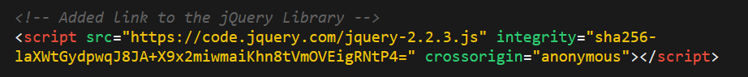
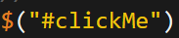
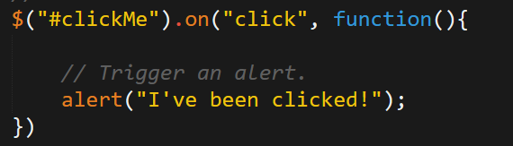
Working with jQuery
01
Include a CDN (Content Delivery Network) link to the jQuery script.
02
Utilize the jQuery specific ($) selector.
03
Apply jQuery methods on the selected elements.
jQuery $(Begins)

Slide 16
03-jQueryGenerators (DOM Manipulation with jQuery)
jQuery $(Begins)

Slide 17
Activity: Generating HTML with jQuery
04-jQueryDrinkList
jQuery $(Begins)
Notes:
15 minutes

Slide 18
On-Click Basic (05-OnClickBasic)
jQuery $(Begins)

Slide 19
Partner Activity: Sandwich Clicking 06-SandwichClick
jQuery $(Begins)
Notes:
20 minutes

Slide 20
Partner Activity: Trigger Random 07-TriggerRandom
jQuery $(Begins)
Notes:
12 minutes

Slide 21
Partner Activity: Lottery Generator 08-LotteryGenerator
jQuery $(Begins)
Notes:
20 minutes

Slide 22
Challenge: Number Checker 09-NumberChecker
jQuery $(Begins)
Notes:
20 minutes

Slide 23
Questions?
jQuery $(Begins)

